Slide 1
SMART SURVEILLANCE MODULE
Mini Project and Seminar
Class & Batch:TE 5,L5 Group No:4
Name:
Uma Kale(3527)
Karishma Lunawat(3534)
Mamta Shukla(3536)
Project Guide
Dr. G.V.Bansod
Department of Electronics and Telecommunications
Pune Institute of Computer Technology
Academic Year : 2016 - 2017

Slide 2
OVERVIEW OF TASKS
SR NO. | TASK | DUE DATE | STATUS
1. | Group Formation | 19/12/16 | COMPLETE
2. | Finalization of project title | 22/12/16 | COMPLETE
3. | Literature Survey | 30/12/16 | COMPLETE
4. | Preparation of Synopsis | 06/01/17 | COMPLETE
5. | Purchasing Components | 12/01/17 | COMPLETE
6. | Formation of modules and Task Distribution | 19/01/17 | COMPLETE
7. | Proteus Simulation | 27/01/17 | COMPLETE
8. | Seminar 2 Topic Finalization | 03/02/17 | COMPLETE
9. | MATLAB Simulation | 17/02/17 | COMPLETE

Slide 3
CONTD….
10. | Seminar 2 Presentation | 23/02/17 | COMPLETE
11. | PCB Designing | 02/03/17 | COMPLETE
12. | GSM Module testing | 05/03/17 | COMPLETE
13. | Installation of Firmware and testing on Breadboard. | 16/03/17 | COMPLETE
14. | PCB Printing and soldering of components | - | PENDING

Slide 4
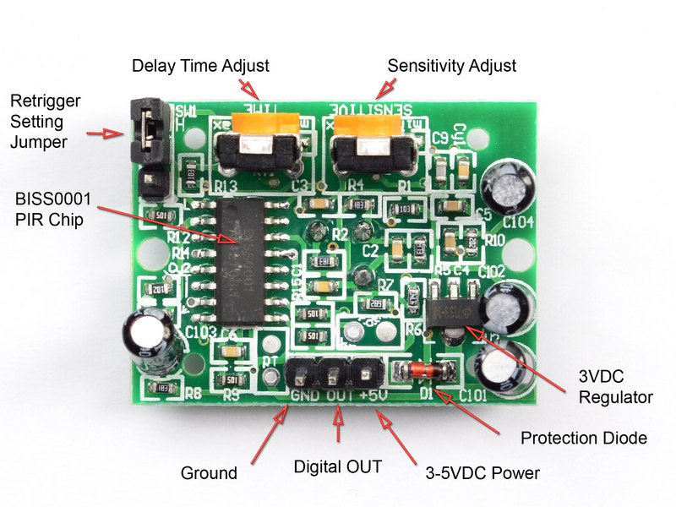
Problem Definition & Objectives
The Project Security System by using web Camera is designed using wireless technology. The objective of this project is to develop a system that monitors the area in which it is being implemented. In this project in automatic mode PIR sensor will detect person movement and give the signal to microcontroller. Other objectives of project are listed below-
1. To reduce cost by using webcam instead of traditional IP cameras.
2. To overcome the shortcomings in IP cameras.
3. To reduce storage requirements and power consumption.

Slide 5
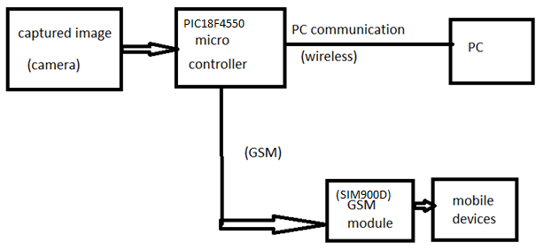
Block Diagram

Slide 7
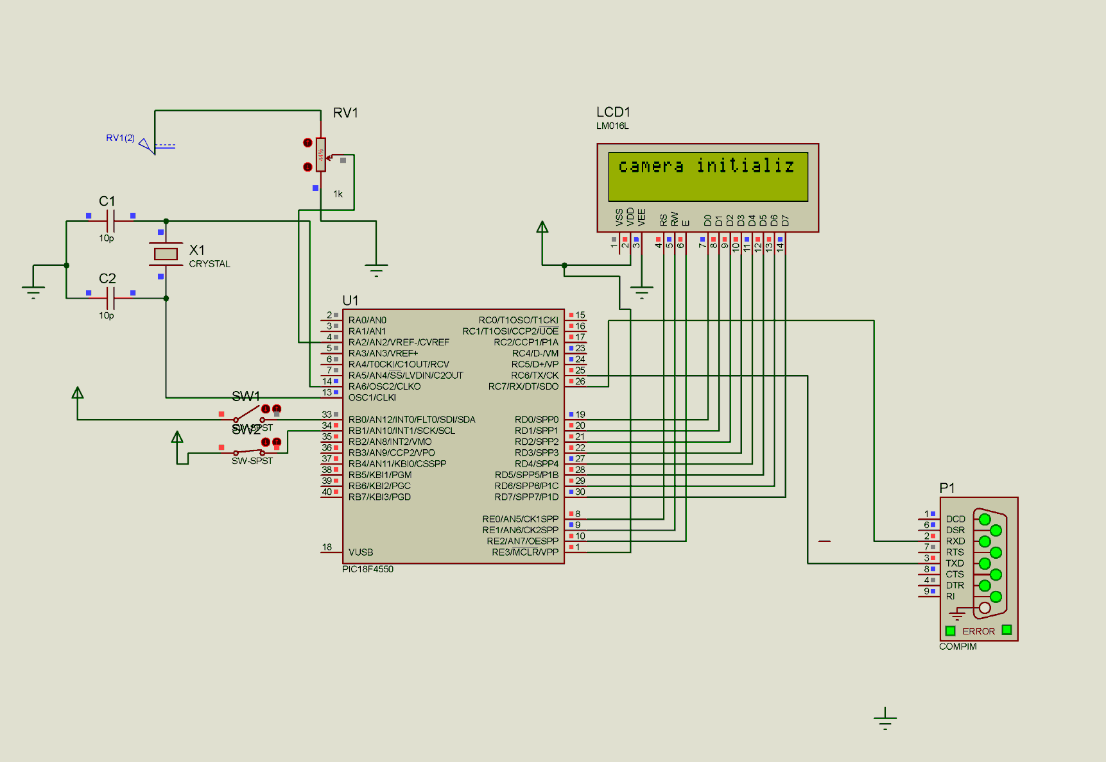
PROTEUS SIMULATION(for camera initialization)

Slide 8
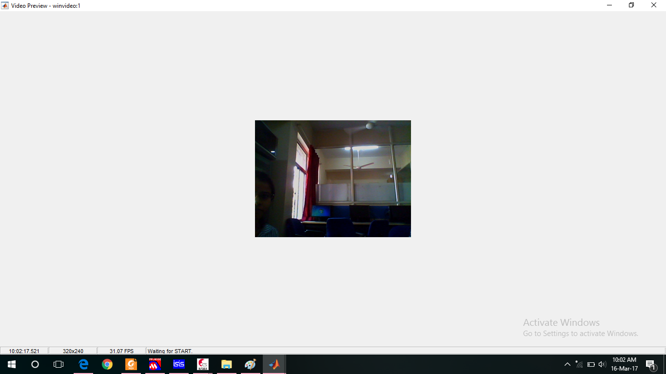
CAPTURED IMAGE

Slide 9
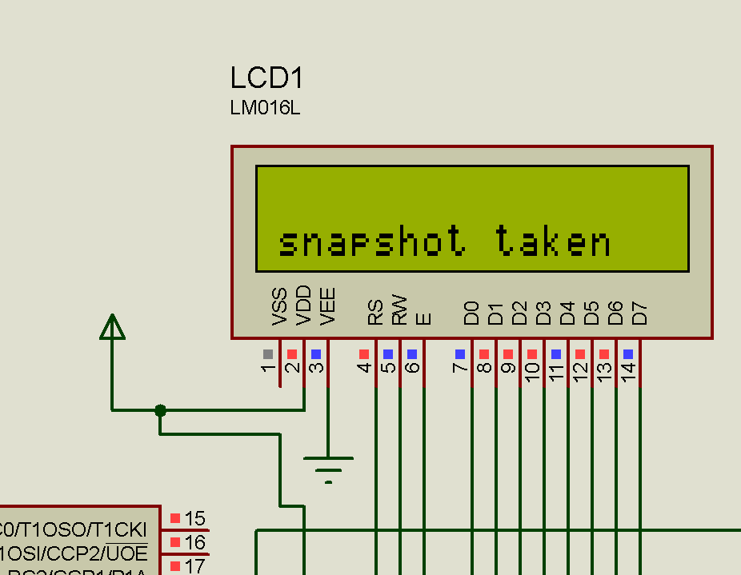
PROTEUS SIMULATION(after image is captured)

Slide 10
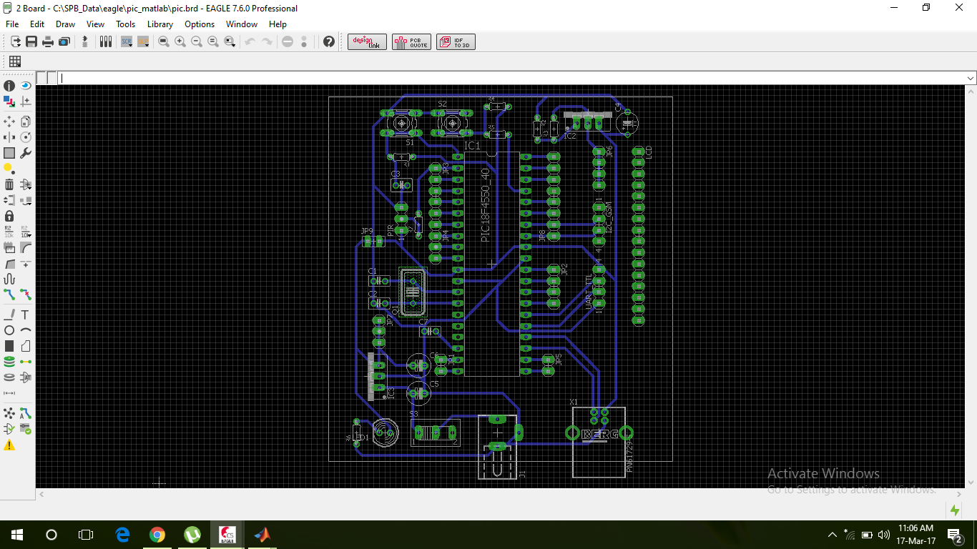
PCB DESIGN

Slide 11
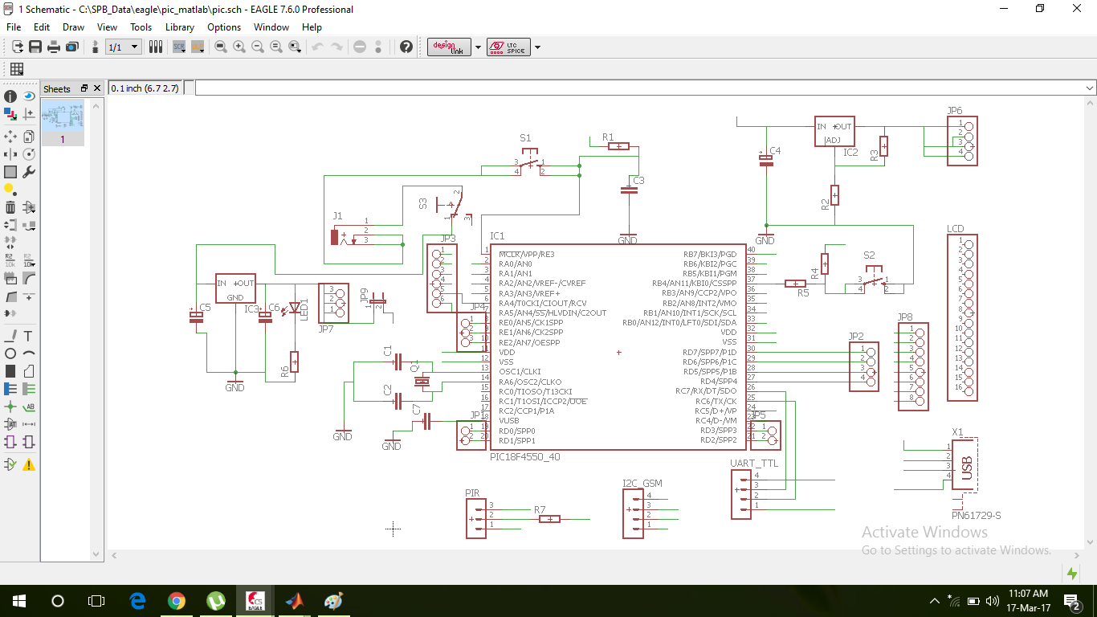
SCHEMATIC

Slide 12
Hardware Requirements
1. Micro-controller PIC18F4550
2. GSM Module-SIM900D
Operating voltage=3.2-4.8 V
SMS+SIMcard interface
GPRS support
3. USB to TTL converter (Programming and data transfer)-
CP2102 USB to TTL UART serial port module
Operating voltage=3.3 V
V2.0 USB support
4. Camera (Webcam/camera module) –
Quantum QHM495LM 25MP Webcam
5. PIR Sensor - HC-SR501 Motion Sensor
Operating Voltage=5V
Range= Operatable from few feet to 20 feet.

Slide 13
Software Requirements
1. MPLABX IDE
2. HID BOOTLOADER
3. Image Processing- MATLAB, Open CV , Python
4.Cadsoft eagle 7.6

